Slide 1
Eurostat activities in the domain of International
Trade in Services Statistics (ITSS)
International Workshop on the Integrated Use of
International Trade Statistics and Economic Statistics
23-25 November 2021

Slide 2
OUTLINE
Overview of Eurostat activities in the Trade in Services domain
Modes of Supply (MoS)
Services trade by enterprise characteristics (STEC)
ITSS by Broad Economic Categories (BEC) Rev.5

Slide 3
Activities in the ITSS domain
Asymmetries analysis
ITSS
ITSS by
partner, product
Methodology
Compliance
Quality reporting
Classifications
Correspondence tables
EBOPS
Add: enterprise characteristics (STEC)
Add: Modes of Supply
ITSS by BEC Rev. 5
CPA
BEC
NACE

Slide 4
OUTLINE
Overview of Eurostat activities in the Trade in Services domain
Modes of Supply (MoS)
Services trade by enterprise characteristics (STEC)
ITSS by Broad Economic Categories (BEC) Rev.5

Slide 5

Why STEC?
  Not only WHAT but
    WHO is trading

Slide 6
Rationale for STEC development
Standard international service trade statistics offer a picture of trade flows between countries, broken down by types of services.
  No insights into the actors, or the types of firms, that are actually engaged in cross-border trade.
  For Goods the same need is already well covered in statistics:
Development on Goods Trade by Enterprise Characteristics (TEC)-initiated jointly by Eurostat and OECD-in response to policy questions on the nature of the actual enterprises engaged in merchandise trade
  First pilot studies started in 2003.
  Today TEC is an well-established statistical area at European level
Notes:
Several EU Member States and EFTA countries use microdata linking techniques to provide to Eurostat, on a voluntary basis, data on STEC

Slide 7
STEC answers users’ needs
Enterprise-level factors (size or ownership) are important determinants of the propensity of enterprises to engage in trade. STEC data can:
  Provide breakdown of trade by key economic characteristics such as size, ownership and type of industry
  Identify the export and import intensity
  Show how firms in different industries purchase and supply goods and services and how this relates to their primary activity.
  Bridge trade in services by Extended Balance of Payments Services (EBOPS) with the industry (economic activity) NACE (ISIC)

Slide 8
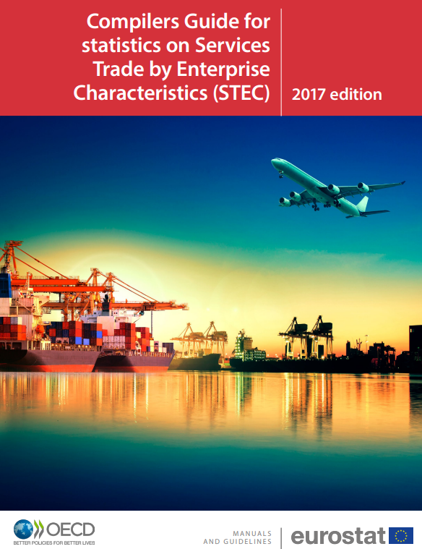

STEC state of play
Eurostat-OECD
STEC Compilers' Guide (2017)
  Currently, STEC data disseminated as experimental statistics
  Statistics Explained article
EBS Regulation (Reg. (EU) 2020/1197)
  STEC becomes official statistic
  First reference year: 2022
Notes:
Several EU Member States and EFTA countries already use microdata linking techniques to provide to Eurostat, on a voluntary basis, data on STEC
With the EBS Regulation STEC becomes official statistic in the EU and EFTA countries

Slide 9
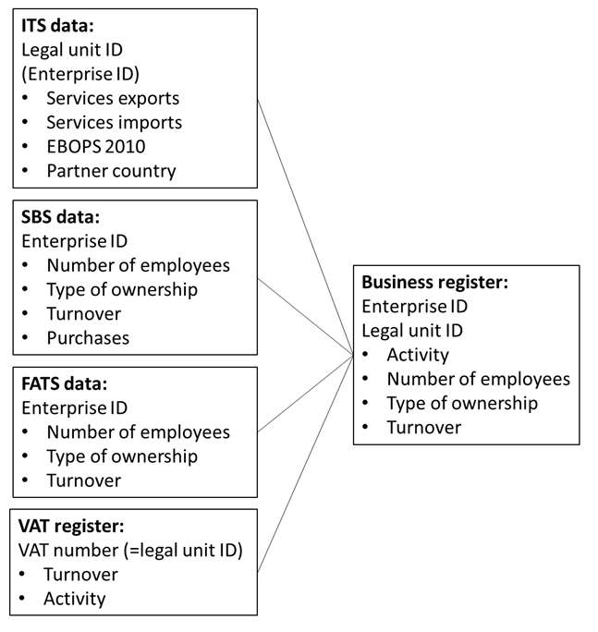
STEC methodology
Microdata linking of ITS data with the Statistical Business Register (and/or other sources)
Low-cost (i.e. no need for a new survey)
ITSS Sample
  Grossing up
NB. non-linkable trade always occurs

Slide 10
STEC – current availability
Trade in services by:
Main activity and enterprise size class
Main activity and type of control
Main activity and type of service
Main activity - exports and imports intensity,
Type of Service and enterprise size class,
Type of Service and type of ownership.
Voluntary data collection
15 countries; 2013-2019
Imports/Exports for partner Intra/Extra EU & World

Slide 11
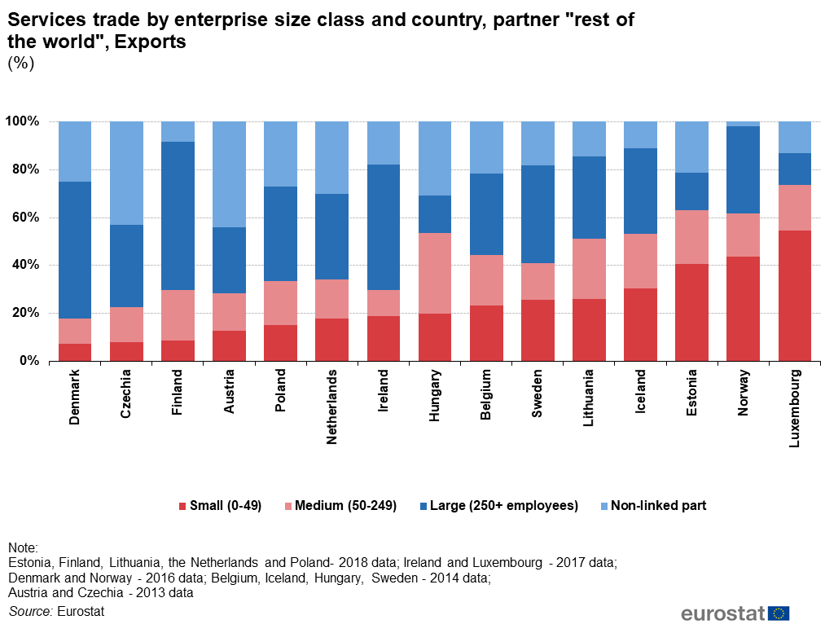
Notes:
Small and medium enterprises account for more than 60% of the exports of services trade in Luxembourg, Norway and Estonia.

Slide 12
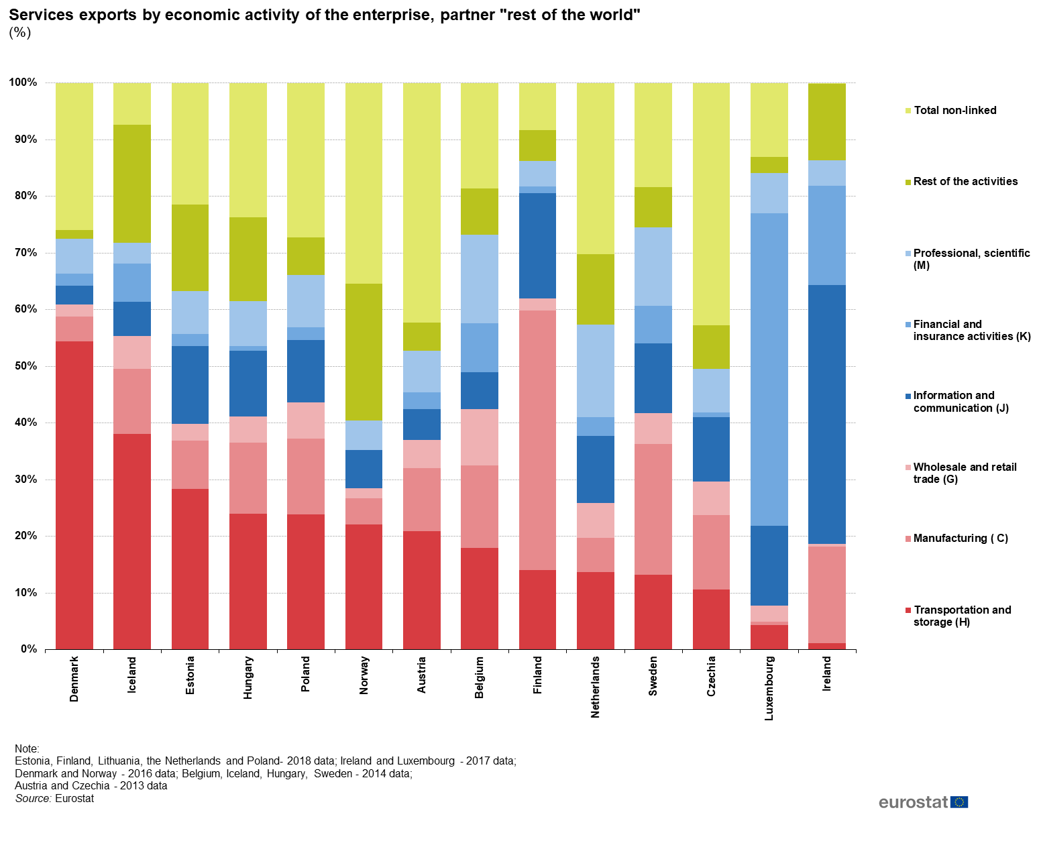
Notes:
Traders in transport and storage activities tend to export the biggest volumes of services, followed by those in manufacturing.

Slide 13
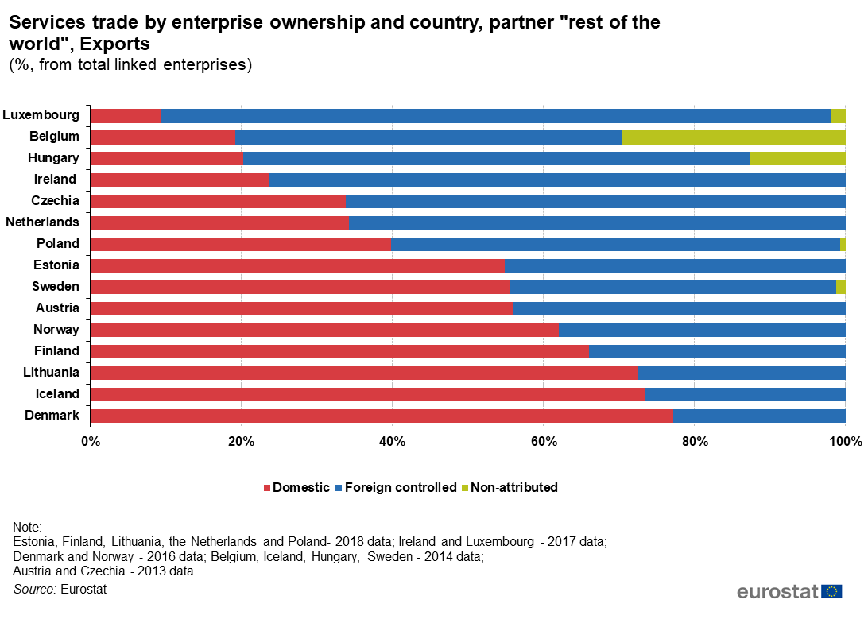
Notes:
Foreign controlled enterprises are responsible for more than 65% of services exports and imports from Luxembourg, Ireland, Hungary, Czechia and the Netherlands.

Slide 14
Data availability with the EBS Regulation
Domain | Breakdowns |  |  | 1st ref. year | Data transmission deadline and date of first data transmission
STEC | 1) Services trade by main activity and size class of the enterprise (SME/Large) 2) Services trade by main activity and type of product (additional geographical breakdown for total services) 3) Services trade by main activity and type of control (domestic / foreign) |  |  | 2022 | T+18 months: June 2024
 |  |  |  |  | Mode 1,2,4 | Mode 3 and Totals
MoS |  | 1) ISS by MoS and geographical breakdown | 2023 |  | T+10 months= end Oct 2024 | T+22 months= end Oct 2025
 |  | 2) ISS by MoS, type of product and geographical breakdown | 2025 |  | T+10 months= end Oct 2026 | T+22 months= end Oct 2027
 |  | 3) ISS by MoS, detailed type of product breakdown and geographical breakdown | 2027 |  | T+10 months= end Oct 2028 | T+22 months= end Oct 2029

Slide 15
OUTLINE
Overview of Eurostat activities in the Trade in Services domain
Modes of Supply (MoS)
Services trade by enterprise characteristics (STEC)
ITSS by Broad Economic Categories (BEC) Rev.5

Slide 16
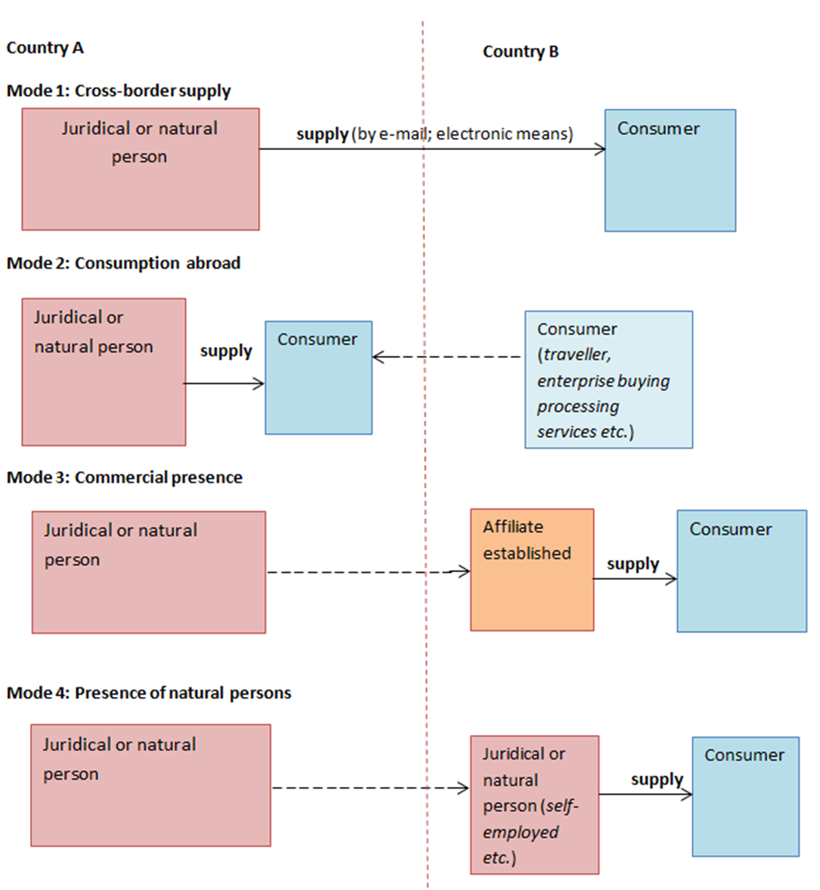
Why Modes of Supply?
WTO’s
General Agreement on Trade in Services-GATS 1995
Notes:
Statistics on total trade in services by modes of supply provides information how and where services are supplied to foreign customers.
The WTO’s General Agreement on Trade in Services, defines trade in services as the supply of a service through any of four modes of supply.

Slide 17
MoS and trade policy needs
The GATS defines trade in services as the supply of a service through four modes of supply:
  Not only standard BoP ITSS but also FATS
This extended dimension of ITS (also known as international supply of services) matters greatly from a trade policy perspective:
  Trade policy makers need statistics to support negotiations of commitments in services and to monitor the results of negotiations.
  For monitoring the implementation of these commitments, politicians, governments and analysts of the public at large require statistics to assess whether such commitments are e.g. trade-creating or trade-diverting.

Slide 18
MoS main sources (MSITS 2010)
Mode 1
ITSS
Mode 2
ITSS
Mode 4
ITSS
Mode 3
FATS
ITGS / TEC
ITSS (construction only)
SBS

Slide 19

Services trade by MoS – state of play
EBS Regulation:
  Services by MoS becomes official statistic
  First reference year: 2023
Statistics Explained article (March 2020)
  Estimations based on “simplified model”
  EU and EU MSs services trade by MoS; 2017
Eurostat MoS Compilers' Guide:
  1st edition Dec 2021
  2nd edition Dec 2023

Slide 20
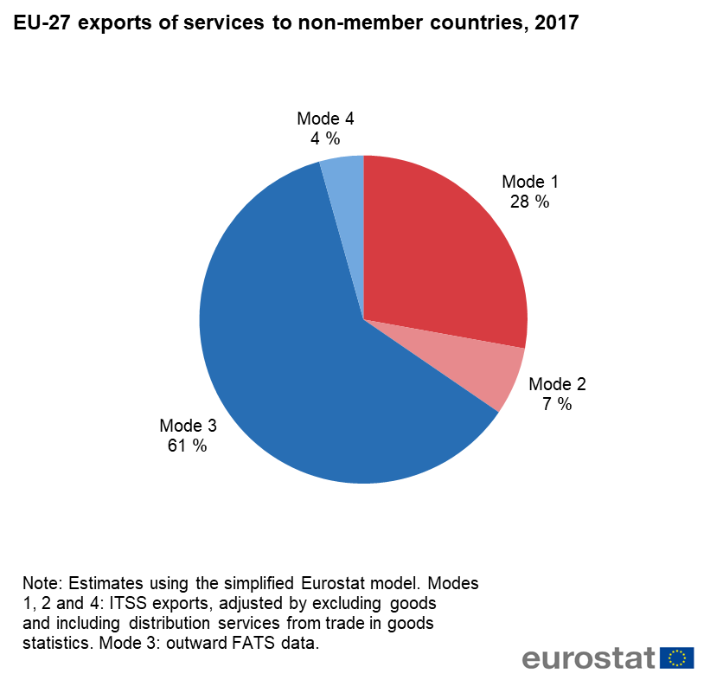
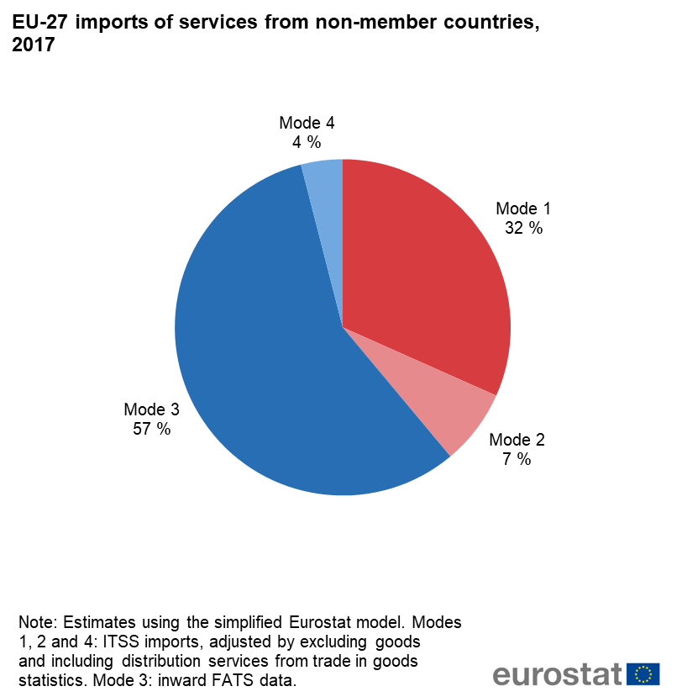
Looking at the data; Eurostat estimates

Slide 21
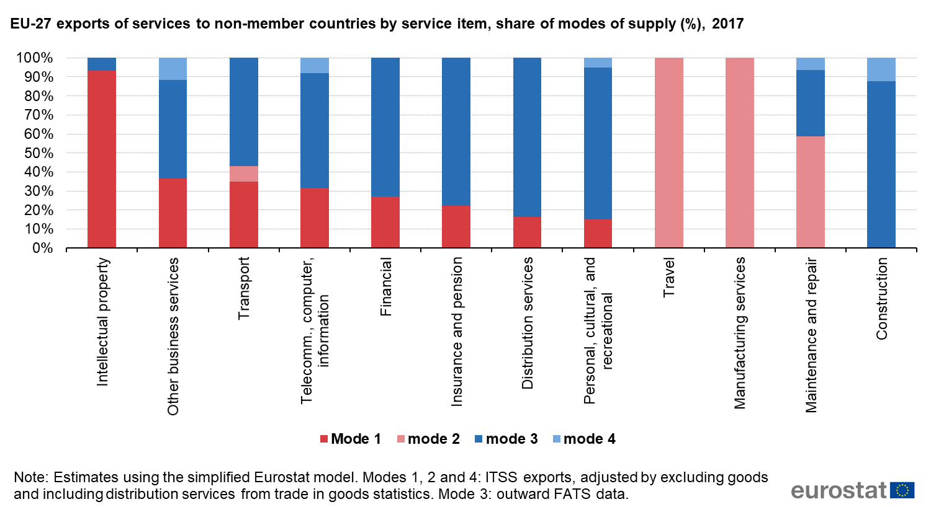

Slide 22
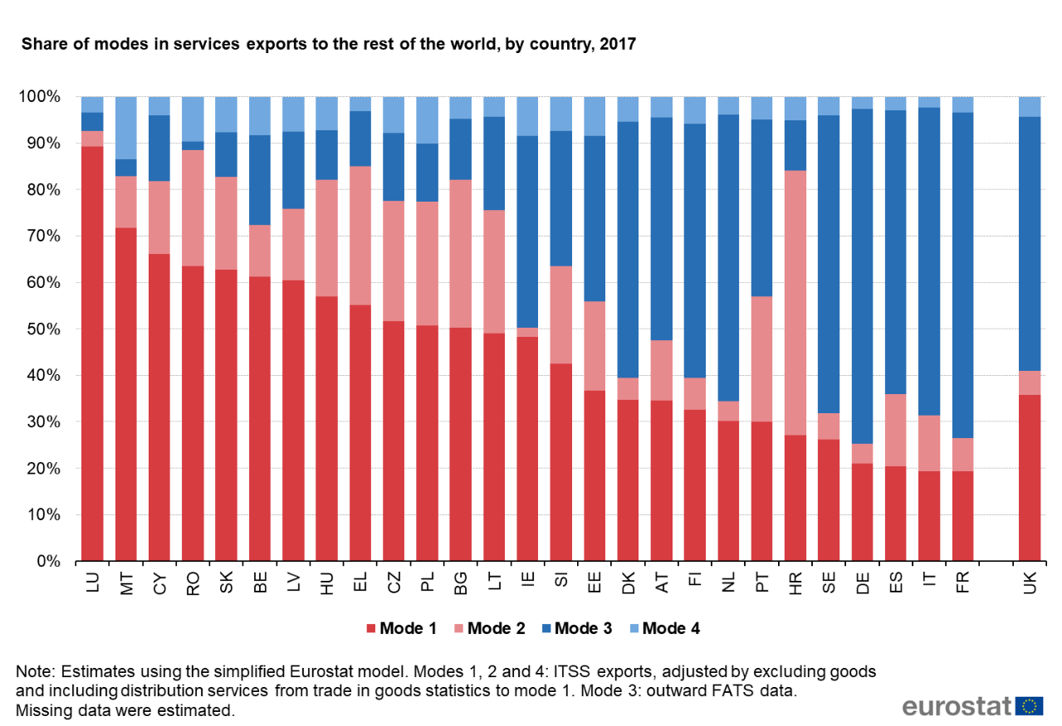
Notes:
Share of services exported through mode 3 is more significant for France, Italy, Germany and Sweden; services imported through mode 3 are more significant for Czechia, Romania, Slovakia and Bulgaria.

Slide 23
Modes of Supply Compiler’s Guide
1st edition – Dec 2021
Eurostat Task Force on MoS to draft MoS guide
  Note the international participation
The guide complements the MSITS 2010
Although the guide is a Eurostat guide, the methodology is international (and can be applied by any country)
  In the next step, the methodology will be integrated in the update of the MSITS
Members:
  WTO, OECD, UNSD
  DG TRADE
  14 EU/EFTA countries
  US BEA
  Statistics Canada
Meetings:
  March 2020
  November 2020
  March 2021

Slide 24
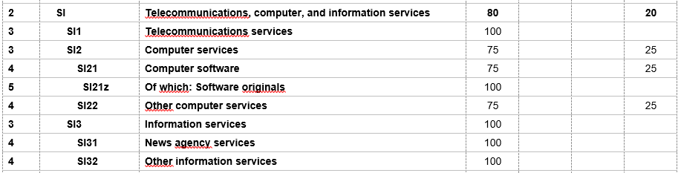
What is new? (1)
The new Eurostat-WTO generic model:
  Consolidates the approaches developed by:
    Eurostat (Eurostat simplified model) and
    WTO (TiSMoS model);
  Builds upon the simplified approach of the MSITS 2010 and MoS estimations from several countries;
  Proposes improved distribution of the modes across the EBOPS items.
  Different allocation shares are proposed for the main and sub-items
Level | EBOPS 2010 |  | Mode type (%)
 | Category | Category description | M1 | M2 | M3 | M4

Slide 25
International Supply of Services by Modes of Supply
Eurostat-WTO model
Distribution services (from Goods)
Adjustments:
  Remove Goods
  local turnover
  remove goods
Mode 1
ITSS from BoP
Mode 2
Mode 4
International supply of services
FATS
Mode 3
Construction (as a residual part of mode 3)
Advanced techniques (e.g. surveys)

Slide 26
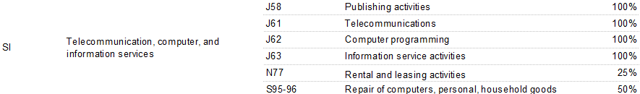
What is new? (2)
Improved correspondence between economic activity classifications (NACE, ISIC) and EBOPS items (for Mode 3 estimation). Two approaches:
  WTO’s approach ‘hybrid EBOPS’ items, for example:
  Eurostat approach; NACE codes are linked to standard EBOPS items (applicable for the EBS Regulation), e.g.
Decision trees / advice how to distinguish complex cases, including multimodal supply
Notes:
Both approaches uses essentially the same main assumptions
- Eurostat’s approach uses standard EBOPS items, however some additional assumptions are needed
- WTO’s approach bridges between NACE/ISIC and EBOPS (bringing together similar products)

Slide 27
The way forward…
The 2nd edition, published by 2023.
Improved techniques / advanced issues, eg:
  Country-specific (data-driven) shares to distribute each EBOPS category to one or more modes
  Mapping NACE (ISIC) to EBOPS codes (needed for Mode 3 consolidation)
  Dealing with multimodal supply of services.

Slide 28
Data availability with the EBS Regulation
Domain | Breakdowns | 1st ref. year | Data transmission deadline and date of first data transmission
STEC | 1) Services trade by main activity and size class of the enterprise (SME/Large) 2) Services trade by main activity and type of product (additional geographical breakdown for total services) 3) Services trade by main activity and type of control (domestic / foreign) | 2022 | T+18 months: June 2024
 |  |  | Modes 1, 2, 4 | Mode 3 and Total MoS
MoS | 1) Total Services by Mode and geographical breakdown | 2023 | T+10 months: Oct 2024 | T+22 months: Oct 2025
 | 2) Services by Mode, type of product (EBOPS main categories) and geographical breakdown | 2025 | T+10 months: Oct 2026 | T+22 months: Oct 2027
 | 3) Services by Mode, detailed type of product and geographical breakdown | 2027 | T+10 months: Oct 2028 | T+22 months: Oct 2029

Slide 29
OUTLINE
Overview of Eurostat activities in the Trade in Services domain
ITSS by Broad Economic Categories (BEC) Rev.5
Modes of Supply (MoS) data and Compiler’s Guide
Services trade by enterprise characteristics (STEC)

Slide 30
ITS by BEC Rev.5
BEC Rev.5: includes the services dimension for the 1st time
BEC helps understand the predominant use of goods and services
Relevant for GVC analysis:
  Intermediate services (and goods) are of particular interest for GVC analysis

Slide 31
Eurostat estimations
Eurostat estimated for the first time the final and intermediate use for the trade in services:
  UN mapping table: EBOPS/CPC/BEC,
  STEC statistics, SBS, National Accounts and modelling (count-seed RAS) was used to refine the mapping, where needed
  The derived allocation shares use EU-wide assumptions
Statistics Explained article (September 2021)
  EU and EU Member States
  2013-2020
  Estimations for missing data (so some caution when viewing results)
Next steps:
  Develop refined allocation shares EBOPS → BEC, using country-specific data/assumptions – involve countries

Slide 32
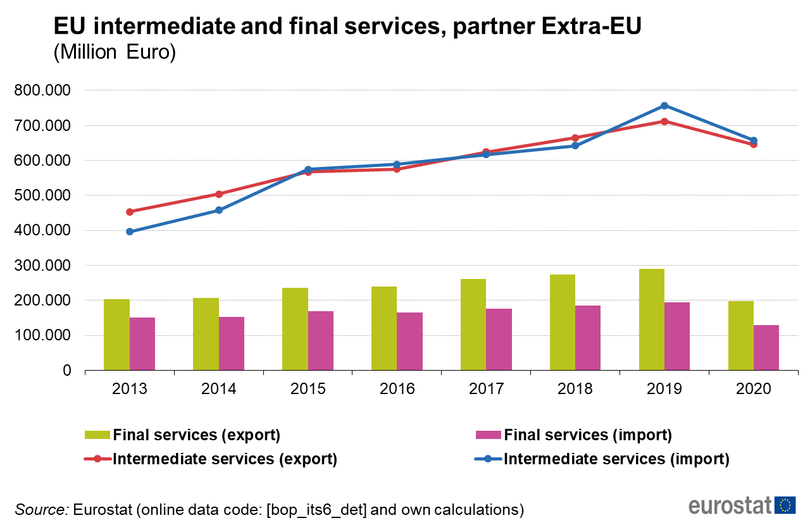
+91%
-13%
+57%
-9%
+43%
+29%
-32%
-33%
Notes:
During the period 2013-20 much more intermediate services cross EU borders each year (about two to three times as many intermediate services are traded compared to final services).
Up until 2019, both intermediate and final services (imports and exports) were increasing steadily each year; intermediate services were increasing at a faster pace compared to final consumption services.
In 2019, both intermediate and final consumption services reached their highest value; imports of intermediate services accounted for EUR 757 billion or about 80% of the total EU imports while exports of intermediate services reached EUR 712 billion (71% of the total EU exports).
In 2013-19, trade in intermediate services between the EU and extra-EU countries increased significantly: for exports, the increase was around 57%, while imports of intermediate services nearly doubled (91% increase)

Slide 33
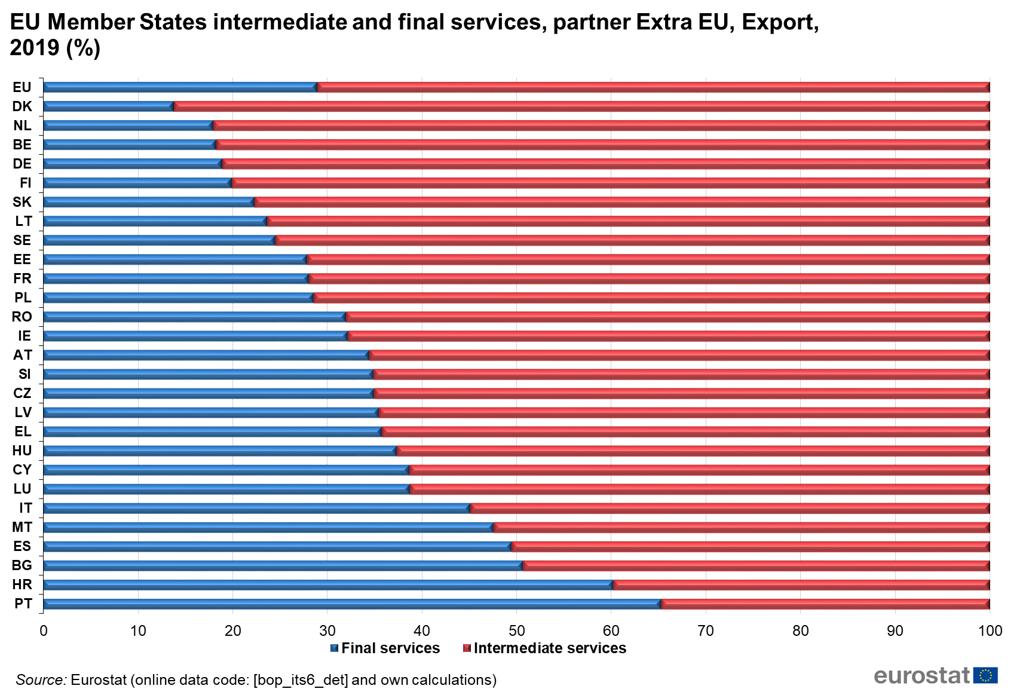

Slide 34
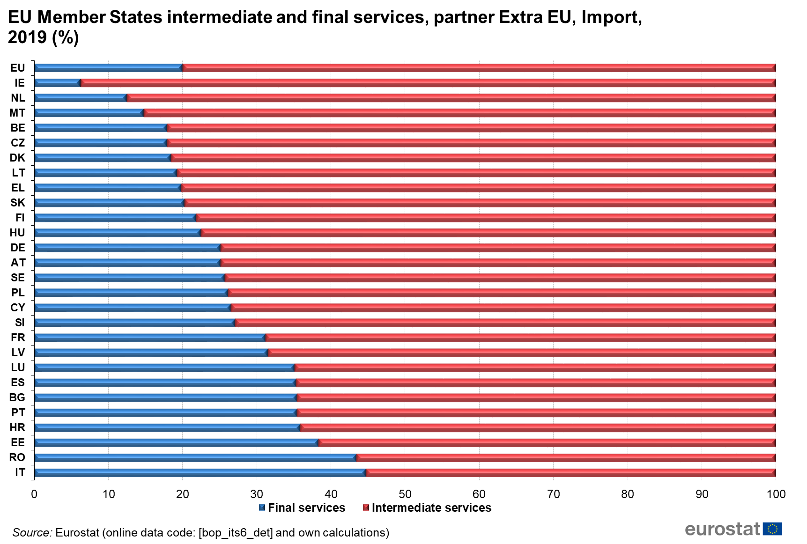

Slide 35

Thank you for your attention!
Contact:
Iliyana.SAVOVA@ec.europa.eu
Georgios.PAPADOPOULOS@ec.europa.eu

